Slide 1

Efficient tools and techniques for modern software development
Visual Studio Code
Vineel Kovvuri

Slide 2
Agenda
IDE vs Text Editor
Interface overview
Basic Editing/Navigation Tricks
The Editor
Multiple Cursors
Extensions
Settings and Customization
References

Slide 3
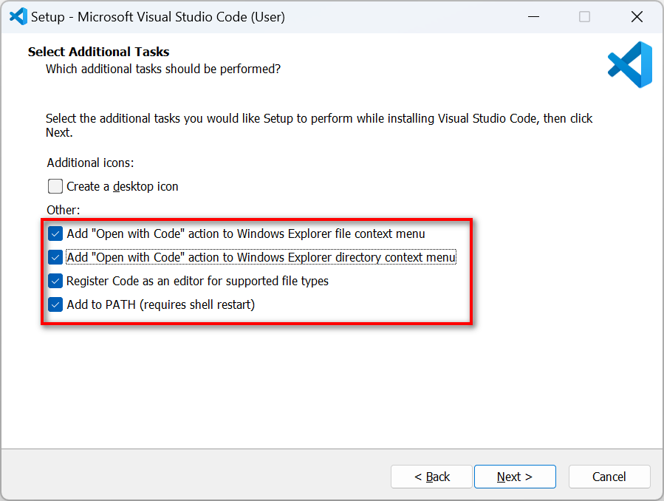
VS Code Installation
https://code.visualstudio.com/download

Slide 4
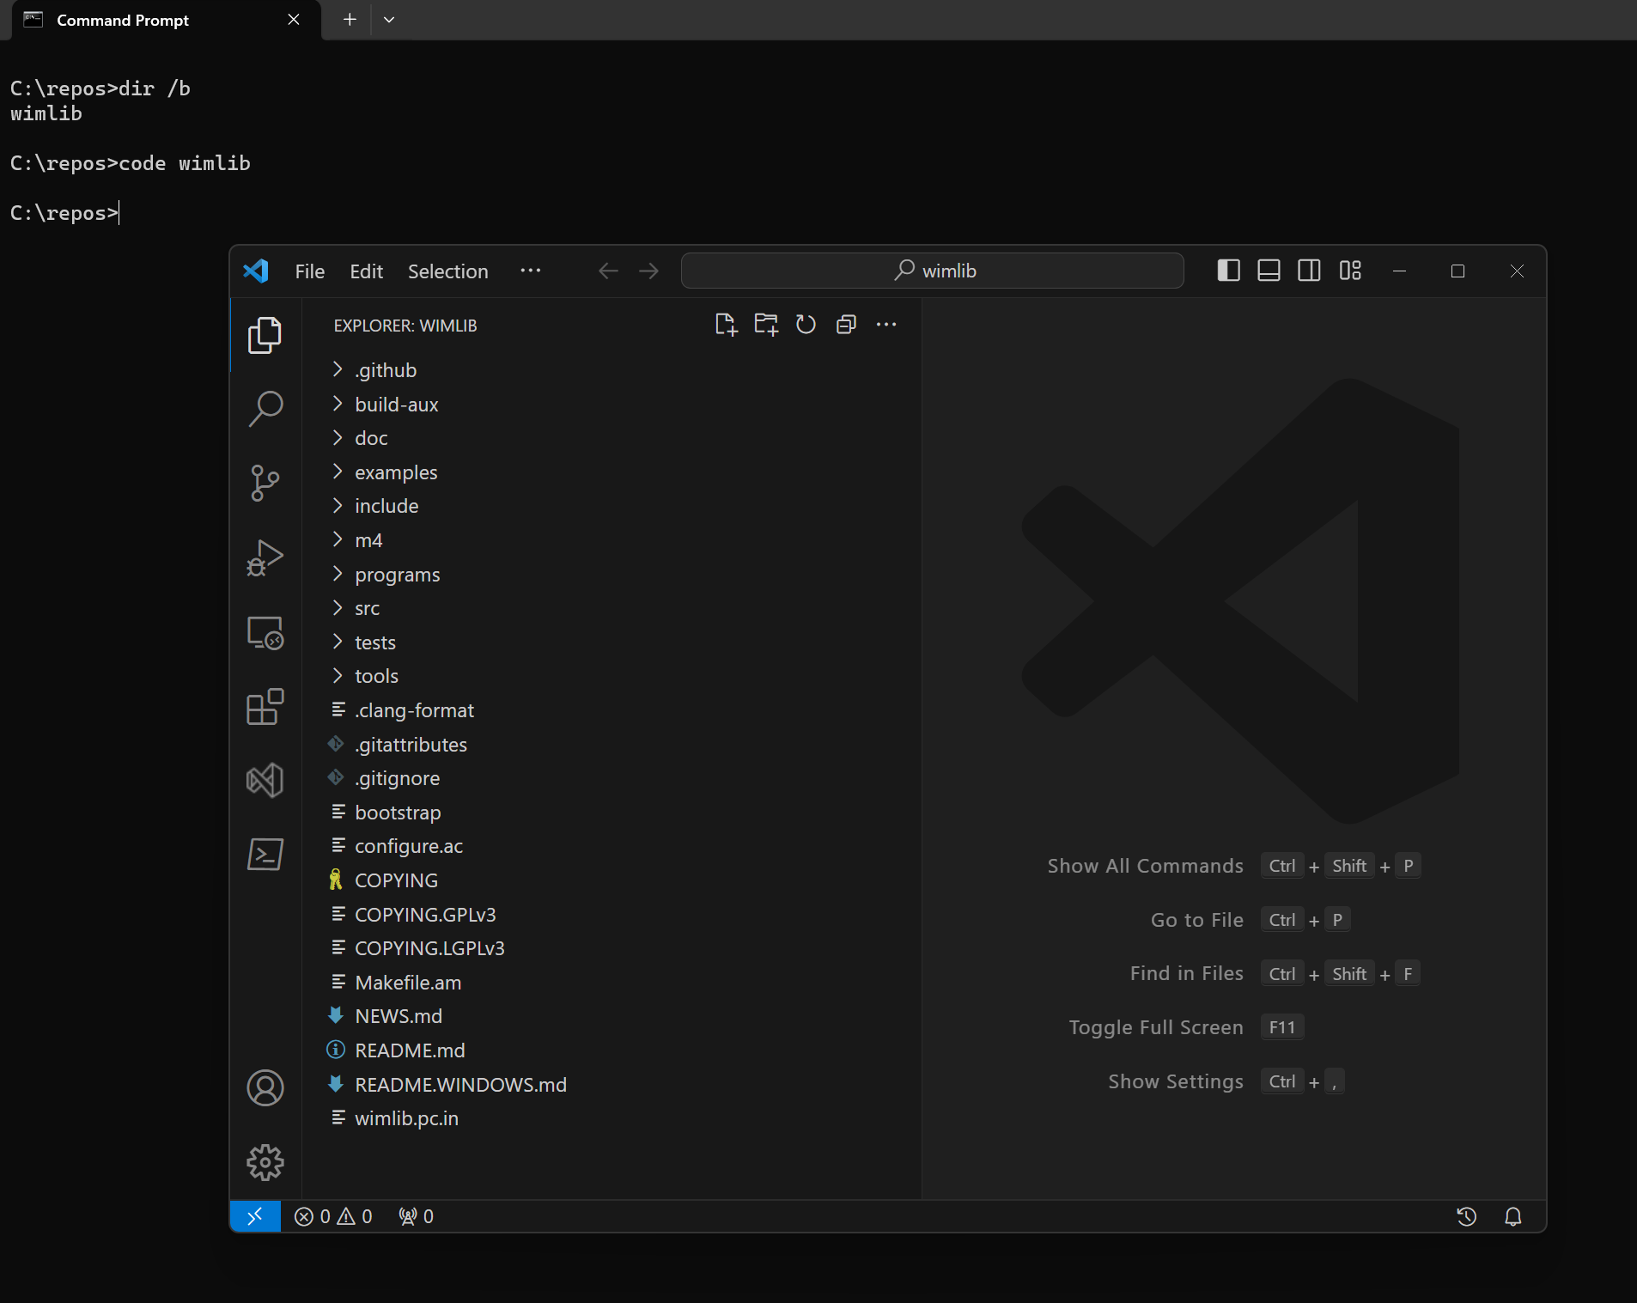
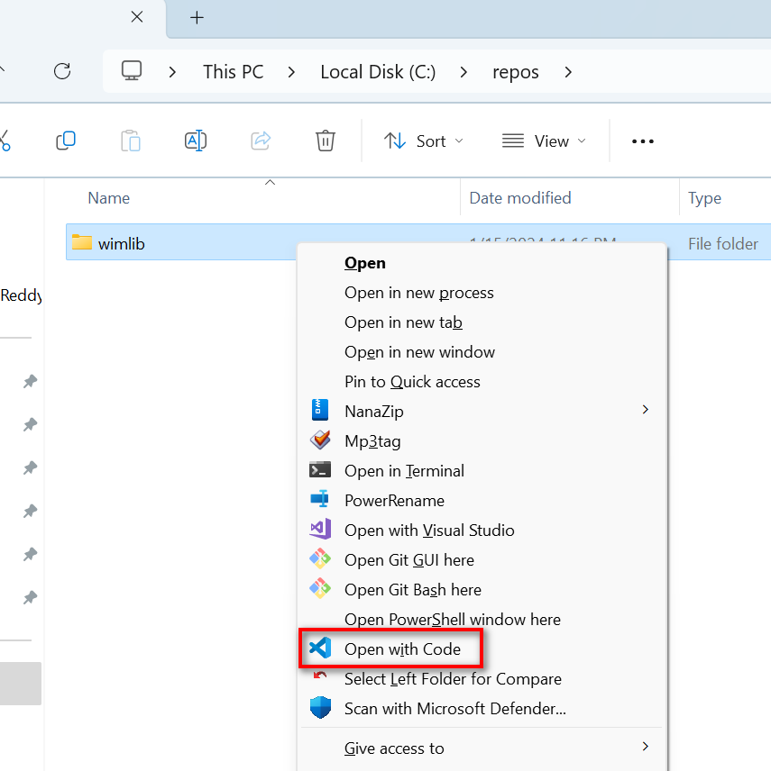
Opening VS Code
Via Explorer Context Menu
Via Command Line – Code.exe
Open single file vs folder

Slide 5
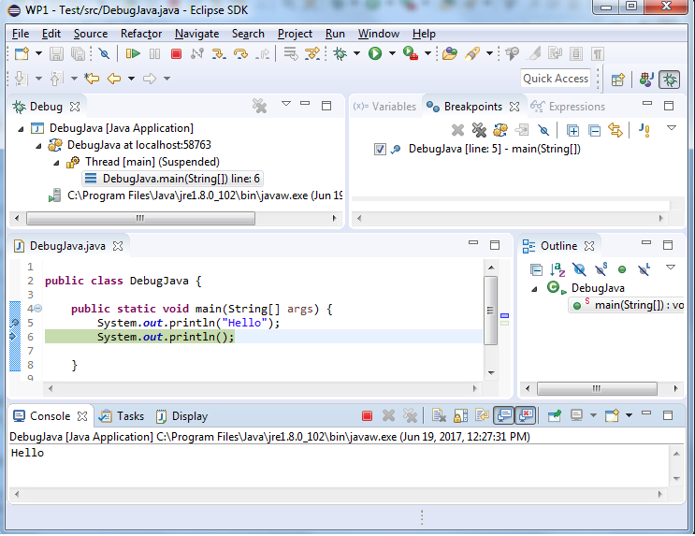
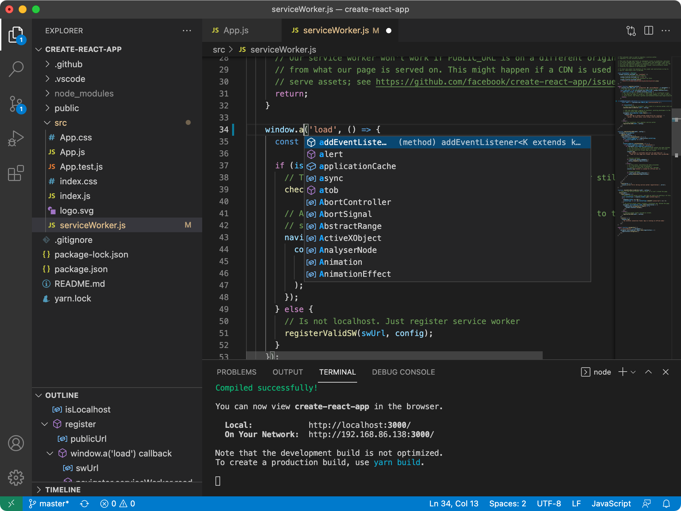
IDE vs Text Editor
IDE(Integrated Development Environment) – Eclispe/Netbeans/Intellij/Visual Studio*
Pros:
They include compilers and integrated tools to build end to end projects
Cons:
Big in size(around few GBs)
Cannot handle large projects
Text Editors – Visual Studio Code/Vim/Emacs
Pros:
Light weight(around few MBs).
Can handle large code bases
Open source
Cons:
Do not include compilers/debuggers.
Building end to end projects require working with build systems separately.
But please do not use Notepad/Notepad++ ☺
*Visual Studio is different from Visual Studio Code

Slide 6
Interface Overview
Traditional Clunky Toolbars vs Command Palette
Ctrl + Shift + P – Open Command Palette
Ctrl + P –Open File from workspace(?)
Fuzzy find file name
File with line number
Ctrl + Tab – List/switch b/w open files
Explorer
Create files with multiple sub directories deep
Reveal in File Explorer
Search inside explorer
Compare Files
Ctrl + ` - Open built in Terminal
Status Bar
Ctrl+B – To minimize the side bar

Slide 7
The Editor
Editor tabs
BreadCrumbs
80/100 Column Guides
Indent Guides
Ctrl + F/H – Find/Replace in current file
Scroll bar search highlights
Ctrl + Shift + F/H – Find/Replace in workspace
Ctrl + Shift + O – Switch b/w functions
Ctrl + \ - Splits
Sticky Scroll
Ctrl + Shift + \ - Find the matching brace
Alt + Left/Right – Navigation history
Remove blank lines
Line Operations(no selection)
Ctrl + C – Copy entire line
Ctrl + X – Cut Line
Shift + Alt + Left/Right – Expand or Shrink Selection
Alt + Down/Up – Move lines

Slide 8
Basic Editing/Navigation in editing text
Left/Right – navigate each character left/right
Ctrl – Jump b/w words
Home/End – Move to beginning and end of the line
Shift – Selection character
Delete/Backspace – deletes the next/previous character

Slide 9
Basic editing walkthrough

Slide 10
Multiple Cursor
Ctrl + D – Create Multiple cursor at next occurrence
Ctrl + Alt + Down/Up – Create Multiple cursors on each line
Each Cursors copies its own select word
Ctrl + Shift + I – Multiple Cursors on all selected lines
Ctrl+F > Search > Alt+Enter – Create multiple cursor on all occurrences in the current file

Slide 11
Multiple Cursors Walkthrough

Slide 12
Extensions
Align
Case conversion(Transform)
Text Pastry - 1 to X
Delete trailing spaces
Commenting flow
Prettier – Code formatter – Shift + Alt + F
VSCode-PDF extension
Rainbow CSV extension

Slide 13
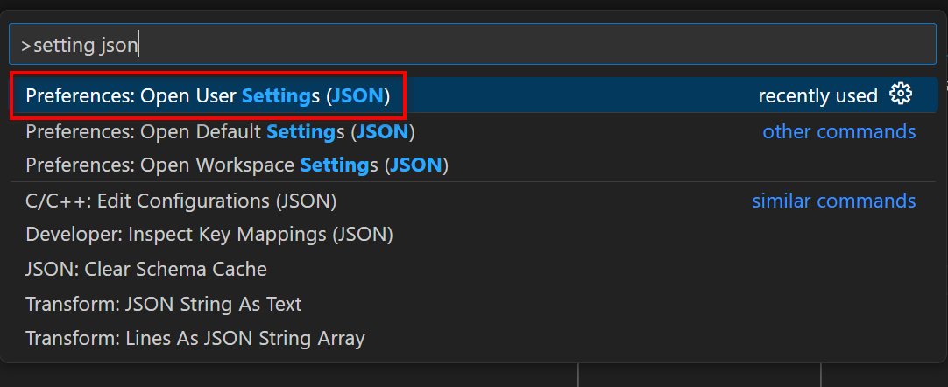
Settings and Customization
My Settings
https://github.com/vineelkovvuri/dotconfig

Slide 14
References
https://stackoverflow.com/
https://www.youtube.com/@code/shorts
https://code.visualstudio.com/docs

Slide 15



Thank You
Vineel.Kovvuri@gmail.com
https://github.com/vineelkovvuri
https://www.linkedin.com/in/vineelkovvuri

